Slide 1
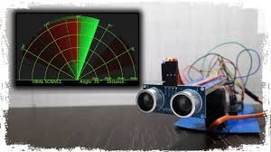
Real-Time Radar System using Arduino & Ultrasonic Sensor
Subtitle: An Engineering-Level Project Presentation with a Literature Survey and Detailed Implementation
Name: Ashwin PAtil

Slide 2
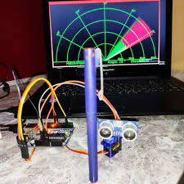
Overview and Objectives
This project demonstrates the fundamental principles of real-time object detection and data visualization. By combining a simple microcontroller with an ultrasonic sensor, we can create a functional, low-cost radar system. The primary goal is to take a physical measurement and translate it into a dynamic, graphical display on a computer screen.
Key Objectives:
Object Detection: To accurately detect the presence and measure the distance of objects within a defined field of view.

Slide 3
Real-time Visualization: To develop a graphical user interface (GUI) that displays the sensor data in a dynamic, radar-like format.
Embedded System Integration: To understand and implement seamless communication between a microcontroller (Arduino) and a desktop application (Processing).
Educational Application: To gain hands-on experience with sensor interfacing, servo motor control, and serial communication, which are foundational skills in robotics and embedded systems.

Slide 4
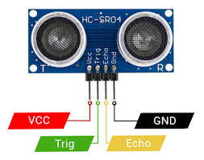
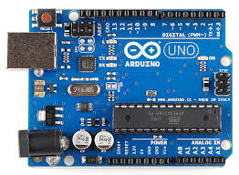
Components (Hardware)
The system is built from readily available and cost-effective electronic and mechanical components.
Arduino Uno or ESP32 Board: The central processing unit of the project. This board is chosen for its ease of use, extensive community support, and robust I/O capabilities, allowing it to control the servo and read from the sensor simultaneously.
HC-SR04 Ultrasonic Sensor: This sensor is the "eyes" of our radar. It works on the principle of echolocation, emitting an ultrasonic sound pulse and measuring the time it takes for the echo to return. The distance is then calculated based on the speed of sound.

Slide 5
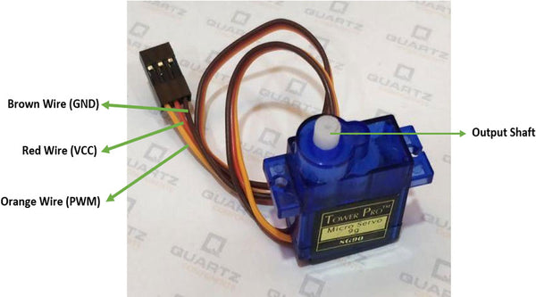
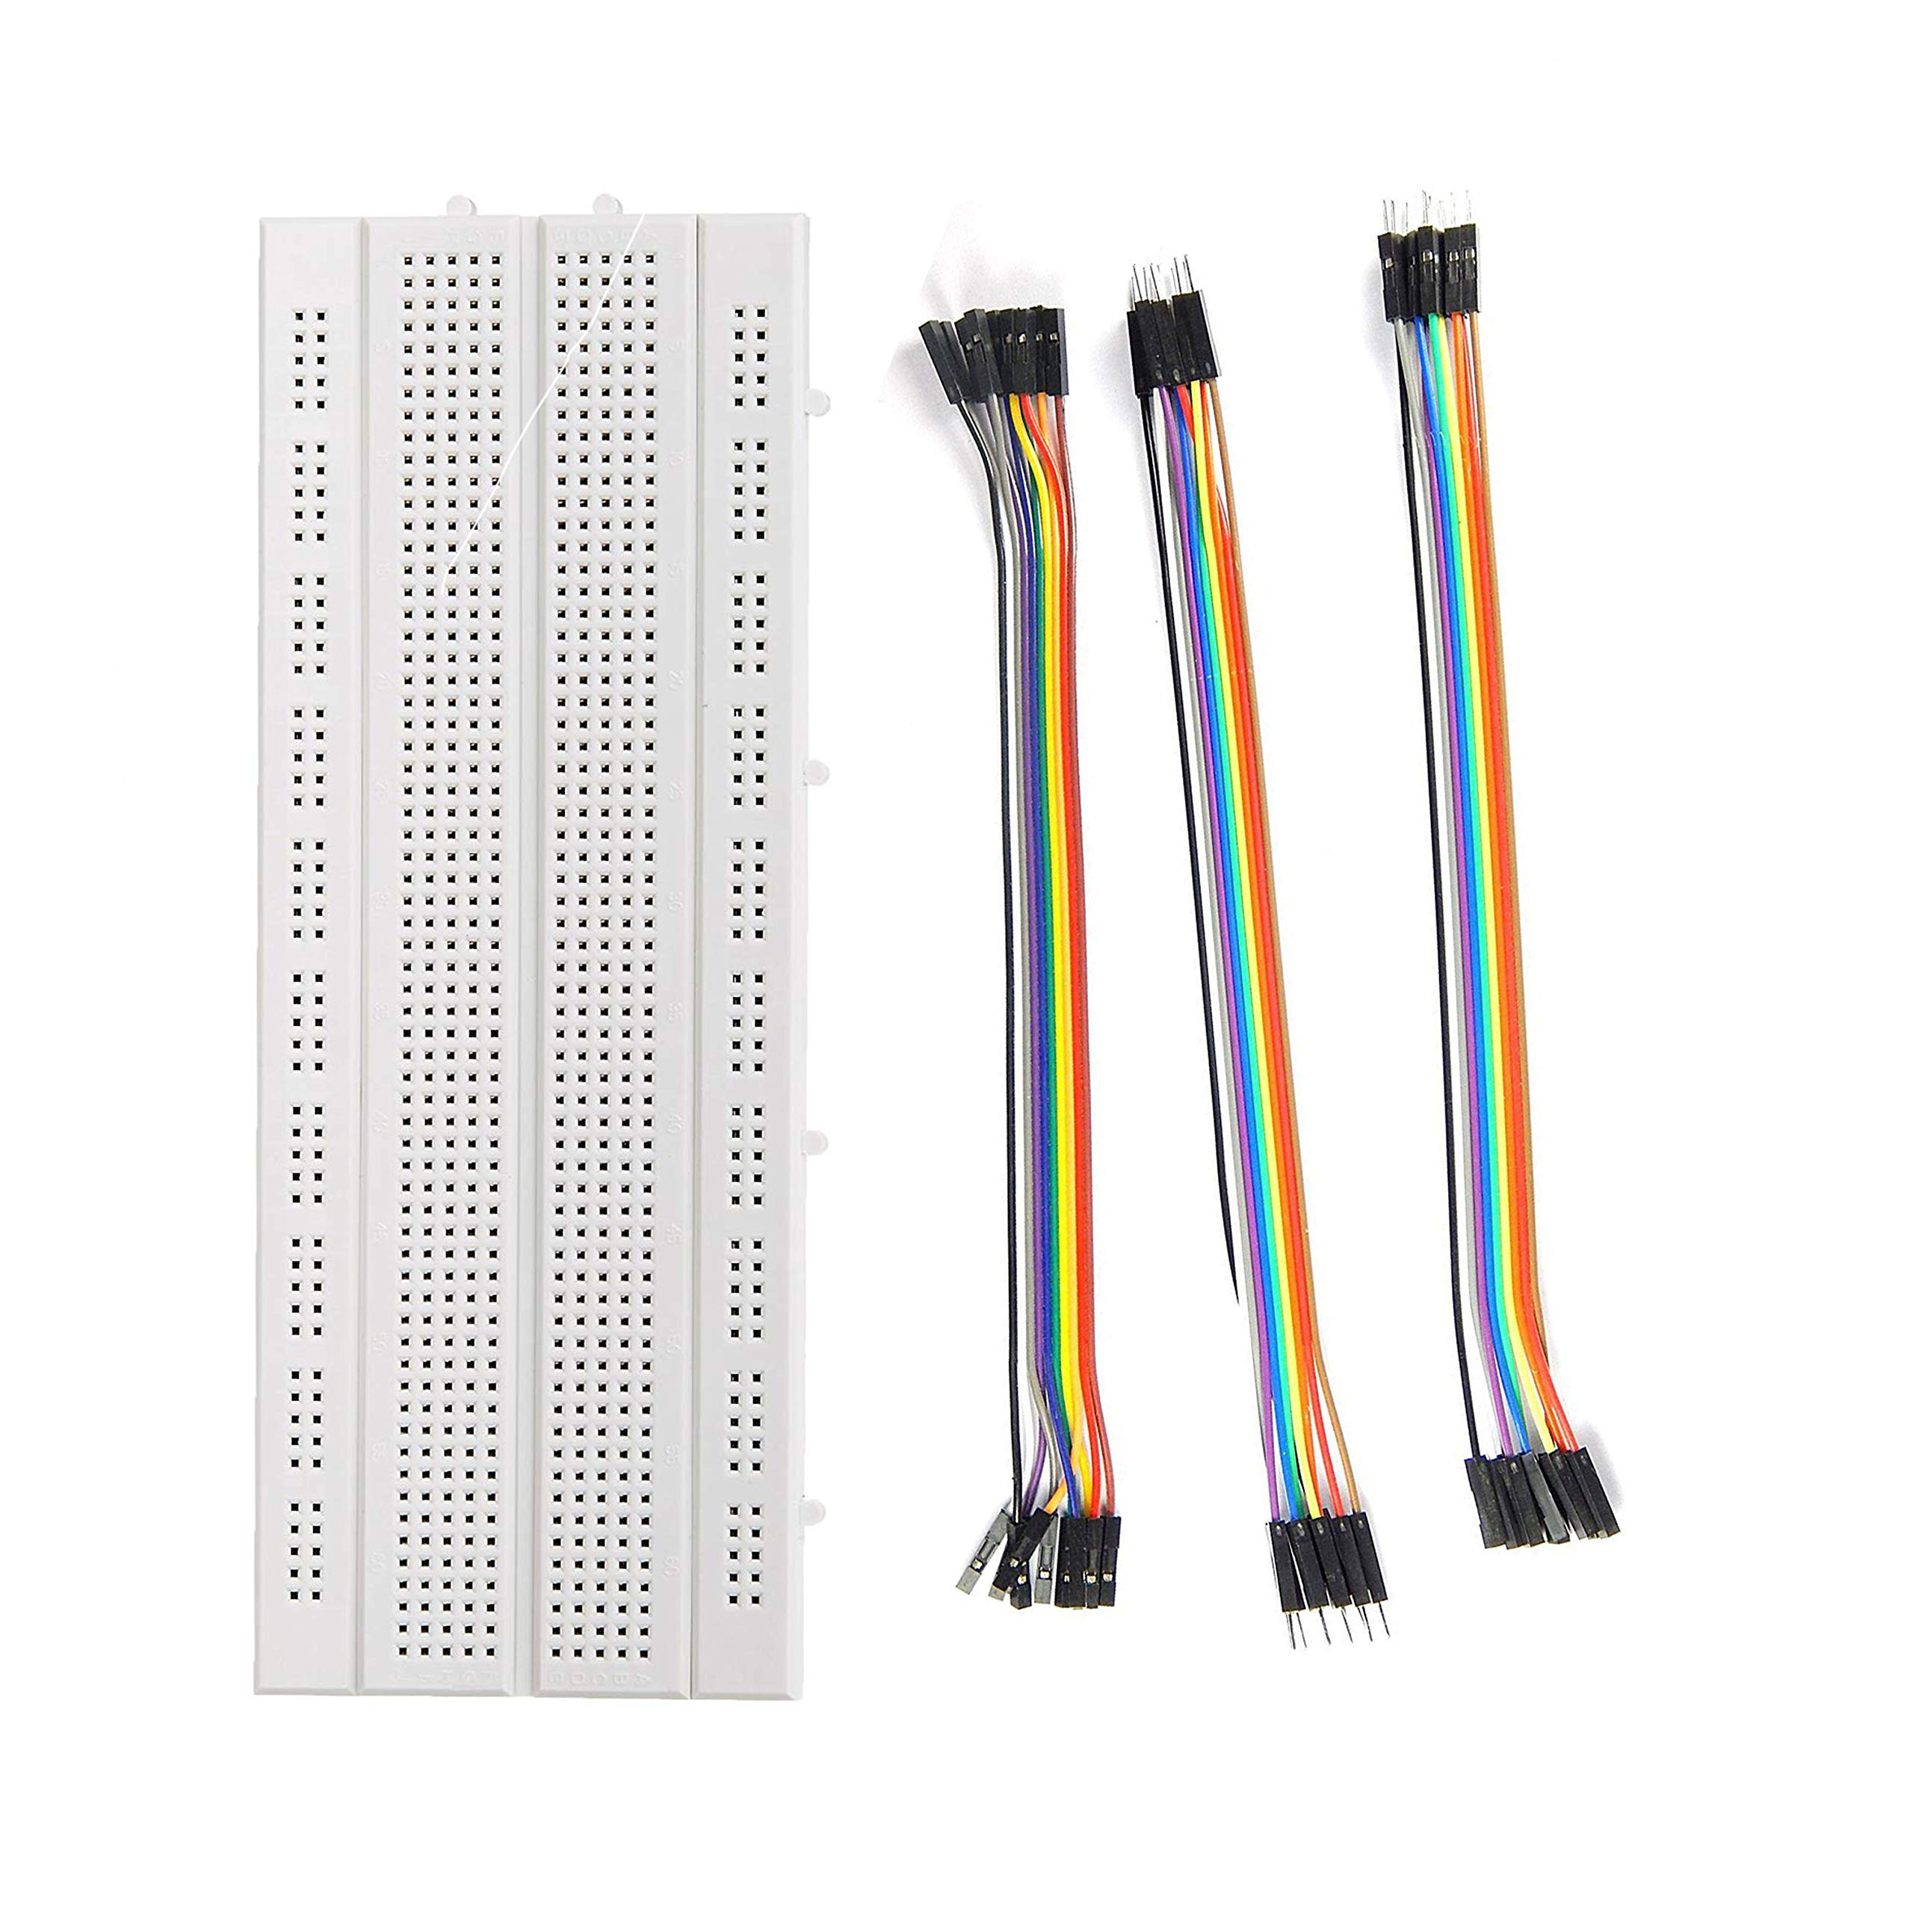
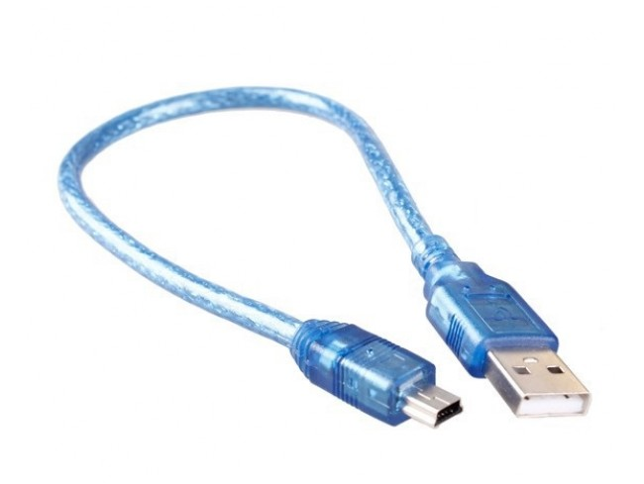
SG90 Micro Servo Motor: This is a small, hobbyist-grade servo that provides precise angular movement. We use it to mechanically sweep the ultrasonic sensor back and forth, allowing us to scan a 180-degree area.
Breadboard & Jumper wires: These components provide a flexible, solderless platform for prototyping and making connections between the components.
USB Cable: Essential for two purposes: powering the Arduino and establishing the serial communication link to transmit data to the computer.

Slide 6


Components (Software & Tools)
The project is a true hybrid, relying on two separate software environments that work together.
Arduino IDE: The programming environment for the Arduino board. The code, or "sketch," written here is responsible for all the low-level hardware control, including commanding the servo and reading from the ultrasonic sensor.
Processing IDE: A powerful programming environment for visual artists and designers, but also an excellent tool for creating quick visualizations. It reads the raw data from the Arduino's serial port and draws the graphical radar screen.

Slide 7
Libraries
Essential Libraries:
Servo.h: A standard Arduino library that simplifies the complex timing signals required to control servo motors.
NewPing.h (Recommended): A specialized library for the HC-SR04 sensor. It offers functions to improve the accuracy and speed of the distance readings, while also preventing common errors like "timeout" issues.

Slide 8
Pin Connections
Accurate wiring is critical to ensure the components communicate correctly. The connections are straightforward and follow standard pinouts.
HC-SR04 to Arduino:
VCC: Connect to the Arduino's 5V pin for power.
GND: Connect to the Arduino's GND pin.
Trig Pin: Connect to a digital I/O pin (e.g., D9). The Arduino sends a signal on this pin to trigger the ultrasonic pulse.
Echo Pin: Connect to a digital I/O pin (e.g., D10). The Arduino listens on this pin for the return echo.
SG90 Servo to Arduino:
VCC (Red wire): Connect to the Arduino's 5V pin for power.
GND (Brown/Black wire): Connect to the Arduino's GND pin.
Signal (Orange wire): Connect to a digital PWM pin (e.g., D11). The Arduino sends a PWM signal on this pin to control the servo's angle.

Slide 9
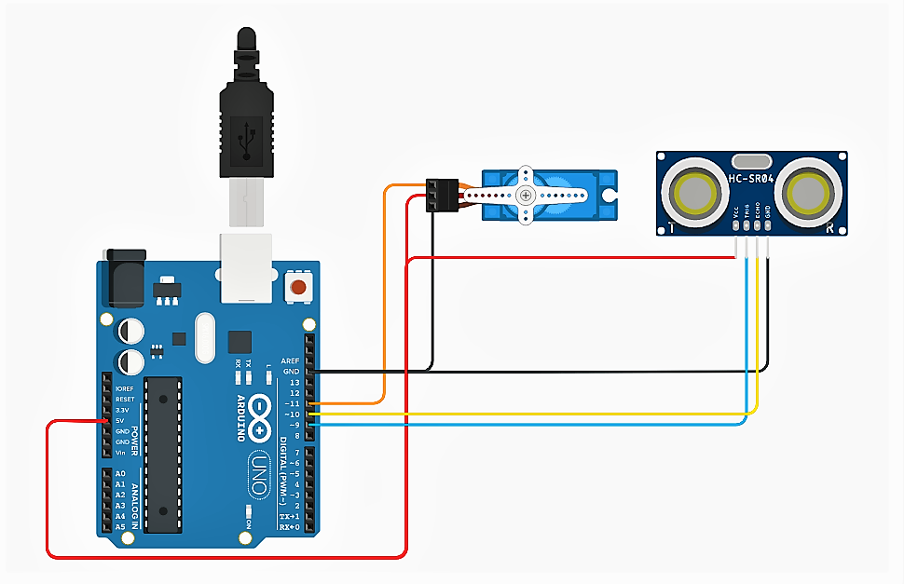
Circuit Diagram

Slide 10
App / User Interface
The Processing sketch creates a compelling, real-time visual experience.
Circular Radar Screen: The GUI is a circular representation of the radar's 180-degree field of view. The screen includes distance markers and degree lines to provide context.
Sweeping Line: A line pivots from the center of the screen, representing the current angle of the servo motor. This provides a clear visual cue of the radar's current scan position.
Object Visualization: When an object is detected, a point or a small circle is drawn at the corresponding angle and distance. The points are designed to fade over time, creating a "trail" that shows the path of a moving object.

Slide 11
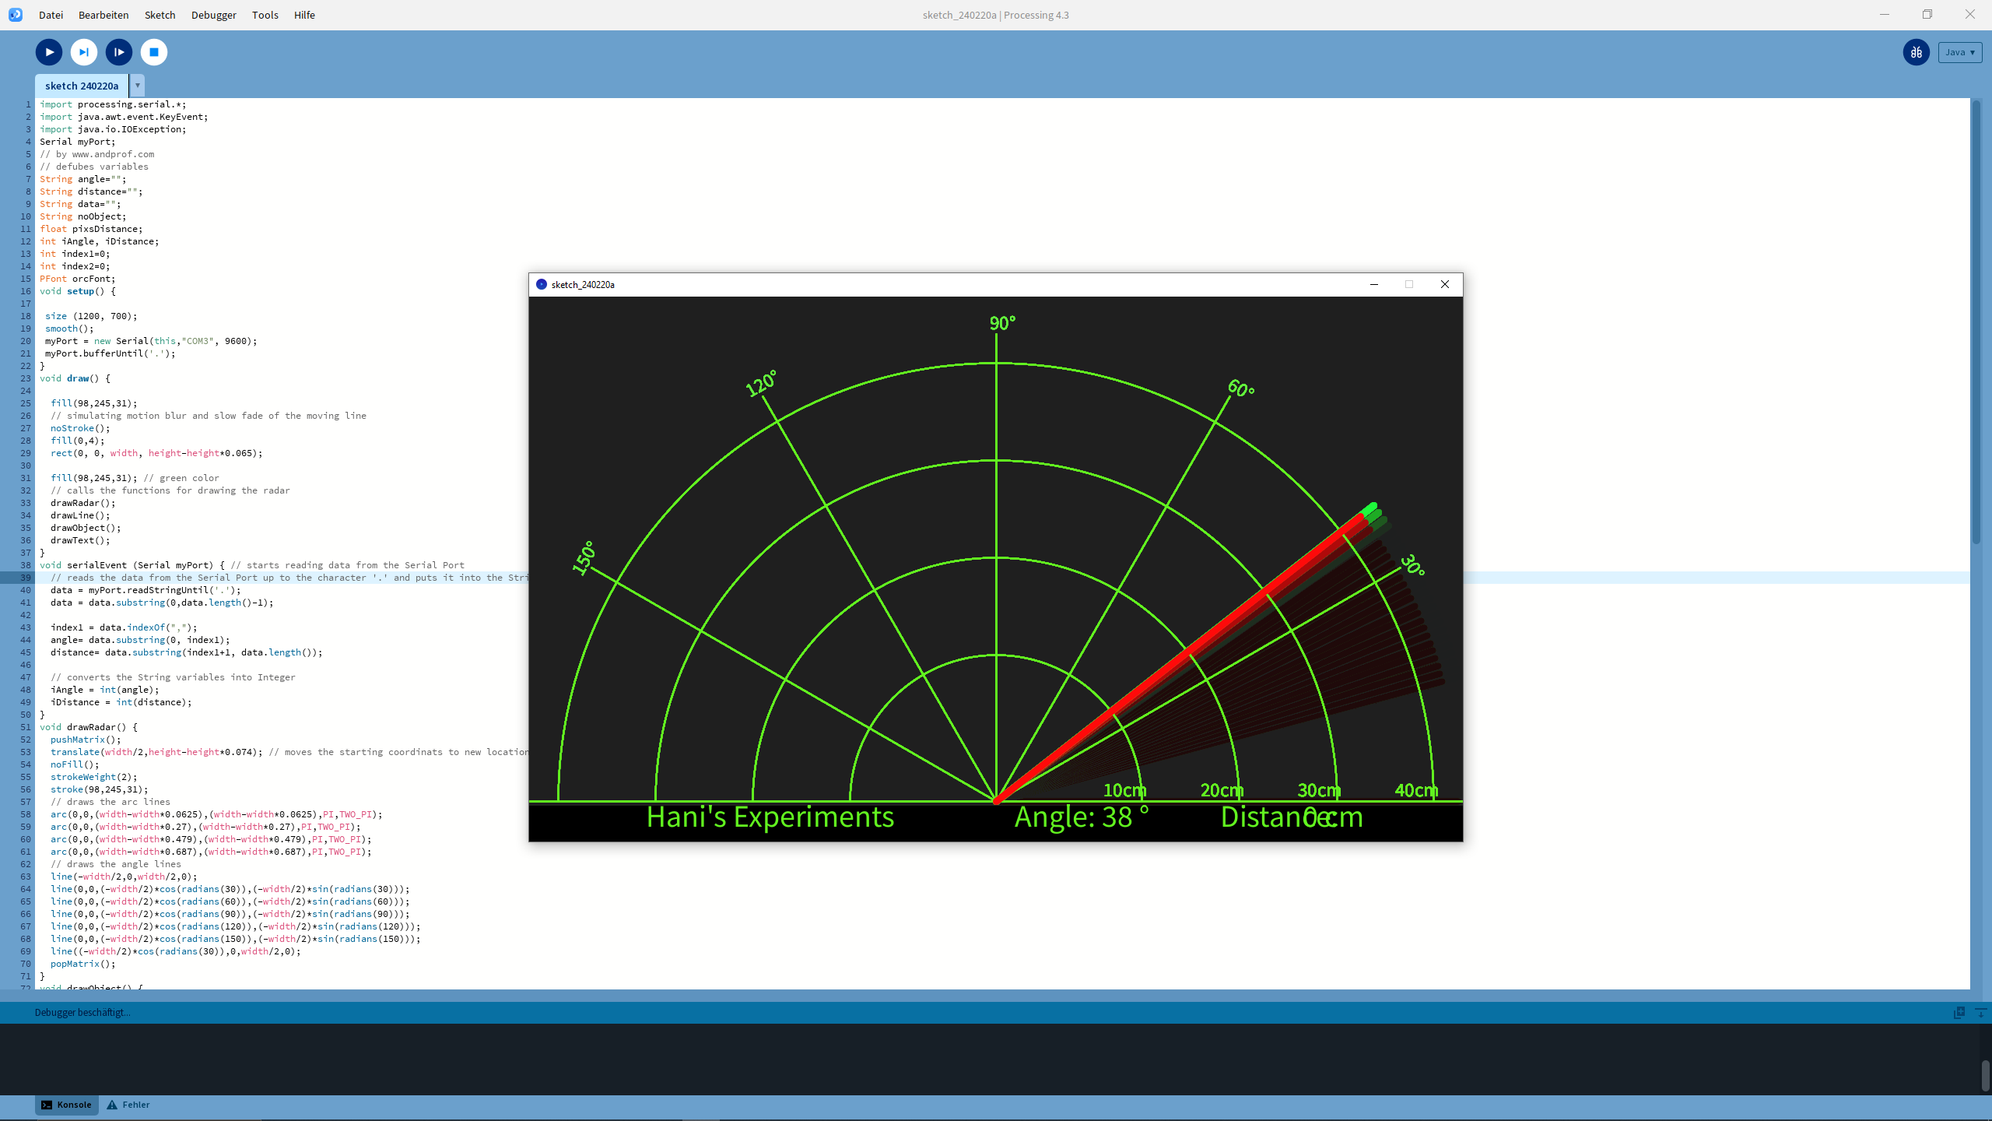
Output Display

Slide 12
Detailed Procedure
Here is a step-by-step procedure for building and running the real-time radar system, including an overview of the code.
Step 1: Prepare the Hardware and Software
First, gather all the components. You will need:
An Arduino Uno or ESP32 board
An HC-SR04 ultrasonic sensor
An SG90 micro servo motor
A breadboard and jumper wires
A USB cable for the Arduino
Next, ensure you have both the Arduino IDE and Processing IDE installed on your computer.

Slide 13
Step 2: Assemble the Hardware
Connect the components on your breadboard following the Pin Connections on Slide 5. This step is critical for ensuring proper communication.
Connect the HC-SR04 sensor:
Connect the VCC pin to the Arduino's 5V pin.
Connect the GND pin to a GND pin.
Connect the Trig pin to a digital I/O pin (e.g., D9).
Connect the Echo pin to a digital I/O pin (e.g., D10).
Connect the SG90 servo motor:
Connect the Red wire (VCC) to the Arduino's 5V pin.
Connect the Brown/Black wire (GND) to a GND pin.
Connect the Orange wire (Signal) to a digital PWM pin (e.g., D11).

Slide 14
Step 3: Program the Arduino
This is where the microcontroller's logic is defined.
Arduino Sketch Overview: The code initializes serial communication and "attaches" the servo motor. The main loop continuously steps the servo motor from 0° to 180° and back. At each angle, it takes a distance reading from the HC-SR04. The two values (angle and distance) are then concatenated into a single string (e.g., "90,123") and printed to the serial port, ready for the Processing sketch to read.
Open the Arduino IDE.
Write the Arduino sketch. The code will instruct the servo to sweep from 0° to 180° and back. At each angle, it will read the distance from the ultrasonic sensor.
The core of the sketch is to take both the angle and distance values and print them to the serial port in a specific format, such as angle,distance. This formatted string is what the Processing sketch will read.
Connect your Arduino board to your computer via the USB cable and upload the sketch.

Slide 15
Step 4: Create the Visualization
This step creates the graphical user interface.
Processing Sketch Overview: This sketch initializes serial communication to listen for incoming data. It also sets up the drawing canvas and creates the static background of the radar. The main loop constantly reads the incoming serial data, parses it, and uses basic trigonometry (x=d×cos(θ), y=d×sin(θ)) to convert polar coordinates to Cartesian for plotting. The code then draws a sweeping line and plots a point at the calculated object location.
Open the Processing IDE.
Write the Processing sketch. This program is responsible for reading the serial data from the Arduino.
The sketch will parse the incoming string to separate the angle and distance values.
The sketch converts the polar coordinates into Cartesian coordinates to plot them on the screen.
The sketch will then draw the radar background, a sweeping line representing the servo's position, and a point for each detected object.

Slide 16
Step 5: Run the System
This is the final step to see your project in action.
Ensure the Arduino is powered on and the sketch is running.
Open the Processing IDE and run your sketch.
The Processing window will open and begin listening for serial data.
Place objects in the path of the ultrasonic sensor and observe them appear on the radar screen. The system will update in real-time as the servo sweeps.

Slide 17
System Flow
The system operates in a tight, continuous cycle of sensing, data transmission, and visualization.
Sensing: The Arduino sets the servo to a specific angle and sends a trigger pulse to the ultrasonic sensor.
Data Acquisition: The sensor returns a pulse whose duration is proportional to the distance. The Arduino measures this pulse and converts it to a distance value in centimeters.
Data Transmission: The Arduino serializes the angle and distance data into a single string and sends it over the USB cable to the computer.
Data Reception: The Processing sketch, listening on the same serial port, receives the data string.
Parsing & Calculation: The sketch parses the string, extracting the angle and distance. It then uses trigonometric functions (x=d×cos(θ), y=d×sin(θ)), to convert the polar coordinates into Cartesian coordinates for plotting on the screen.
Visualization: The Processing sketch draws the sweeping line and the object point on the screen, updating the display in real-time.

Slide 18
Testing & Demonstration
A successful project demonstration requires a systematic approach to testing and validation.
Arduino Test: First, ensure the servo motor sweeps correctly from 0° to 180° and the ultrasonic sensor provides accurate distance readings. The Serial Monitor is invaluable here, showing the raw angle,distance data to confirm that the hardware is working as expected.
Serial Communication Test: Verify that the data is being transmitted reliably from the Arduino and received by the Processing sketch without errors.
Full System Demonstration:
Upload the Arduino sketch to the board.
Run the Processing sketch on the computer.
Observe the radar screen and place objects (e.g., hands, books, small boxes) in front of the sensor to test object detection.
Move the objects around to evaluate the system's responsiveness and accuracy in a dynamic environment.

Slide 19
Challenges & Improvements
Every engineering project has its limitations and opportunities for growth.
Challenges:
Sensor Accuracy: The HC-SR04 can be affected by ambient noise, surface type, and humidity, leading to inaccurate readings.
Servo Jitter: Low-cost servo motors can have "jitter," causing slight inconsistencies in their angular position.
Processing Performance: Drawing a large number of fading points can slow down the Processing sketch, especially on older computers.

Slide 20
Improvements:
Data Filtering: Implement a simple moving average filter on the Arduino to smooth out erratic distance readings and reduce noise.
Better Components: Upgrade to a more accurate sensor (e.g., a LiDAR module) or a higher-quality servo for improved performance.
Wireless Communication: Replace the USB cable with a wireless module (e.g., Bluetooth, or an ESP32 for Wi-Fi) to enable a completely untethered system.
Advanced GUI: Use a more powerful framework like Python with a dedicated GUI library (e.g., Pygame, Tkinter) for more robust features and better performance.

Slide 21
Advantages
Low-Cost: The components are very affordable, making the project accessible to students and hobbyists.
Educational: It provides an excellent, hands-on learning experience for a range of topics, from electronics to programming.
Real-time: The system provides a live, dynamic representation of the environment, making it engaging and interactive.
Open Source: The use of open-source software and hardware makes it easy to replicate, modify, and expand upon.

Slide 22
Disadvantages
Limited Range & Accuracy: The HC-SR04 sensor has a limited effective range and can be prone to errors.
Requires Two Programs: The system requires both the Arduino and Processing sketches to be running simultaneously, which can be cumbersome.
Manual Calibration: The servo's sweep angle may require manual calibration to ensure a precise 180° arc.
Limited Scope: The basic system is a demonstration of principles, not a robust, practical tool.

Slide 23
Future Scope
This project serves as a foundation for many exciting future enhancements.
Automated Object Tracking: Implement an algorithm to track the movement of detected objects over time.
3D Scanning: Use a second servo motor to create a 3D scan of an area.
Enhanced Sensors: Replace the ultrasonic sensor with a LiDAR or Time-of-Flight sensor for greater accuracy and range.
Advanced GUI: Develop a more sophisticated GUI using Python with libraries like Matplotlib or a web-based interface with JavaScript.
Wireless System: Use an ESP32 to host a web server that displays the radar data, eliminating the need for a separate Processing sketch and USB cable.

Slide 24
Conclusion
In conclusion, this project successfully demonstrates a low-cost, real-time radar system. We have learned to interface a microcontroller with both a sensor and a motor, communicate data to a computer, and visualize that data in a dynamic way. The challenges encountered and the insights from the literature survey provide a clear roadmap for future improvements. This project is a foundational exercise in embedded systems, showcasing the power of simple hardware and software to create a compelling engineering application.

Slide 25
Thank You

